Slide 1
Parish Team Meeting
Starting your climb together

Slide 2
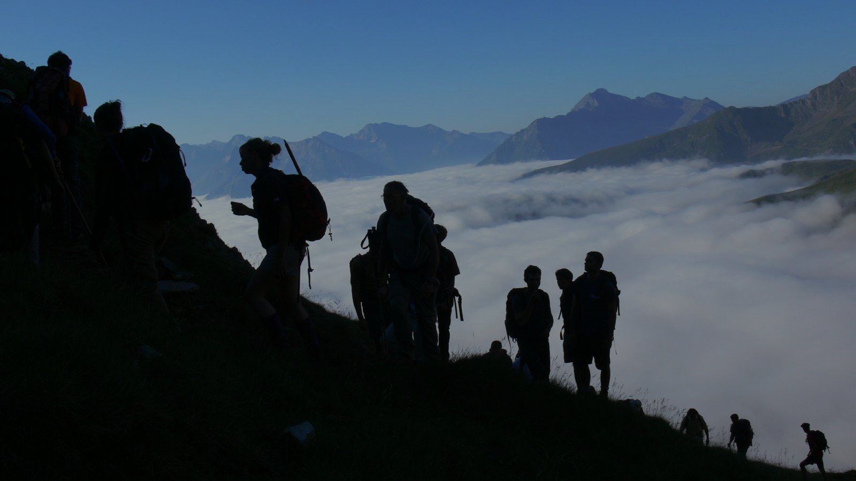
Why are we here?
Notes:
We are here to follow-up on what you learned and discovered at Base camp. Your discipleship team will now move forward TOGETHER to create a Clear Path for Discipleship for your parish (school, etc.) This evening you are going to start your climb and learn tools to help you continue your ascent.

Slide 3
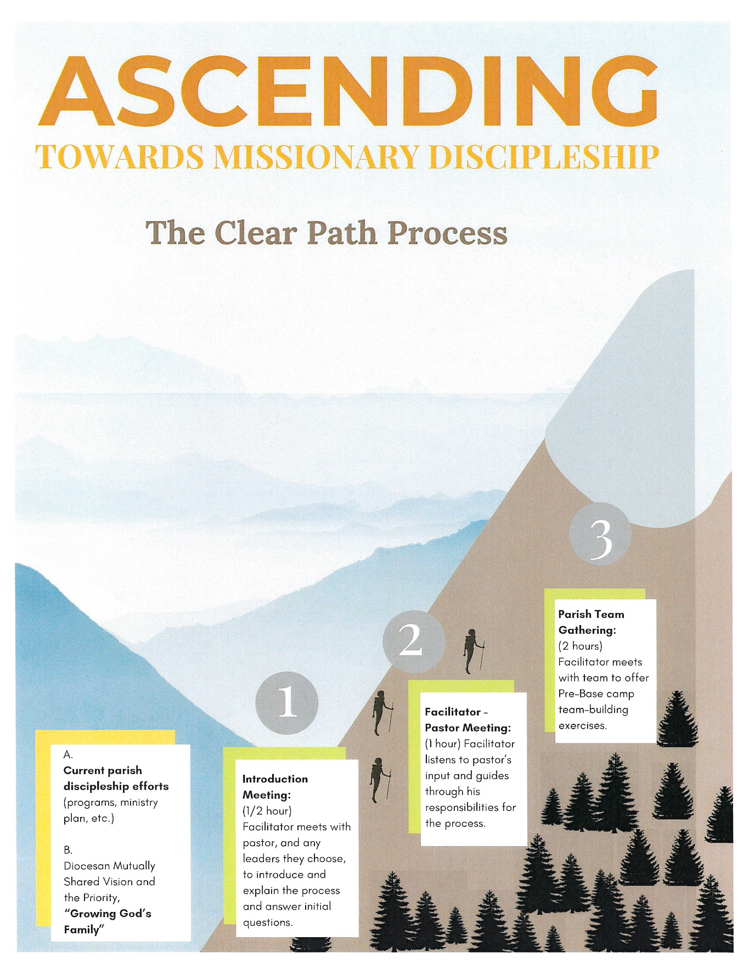
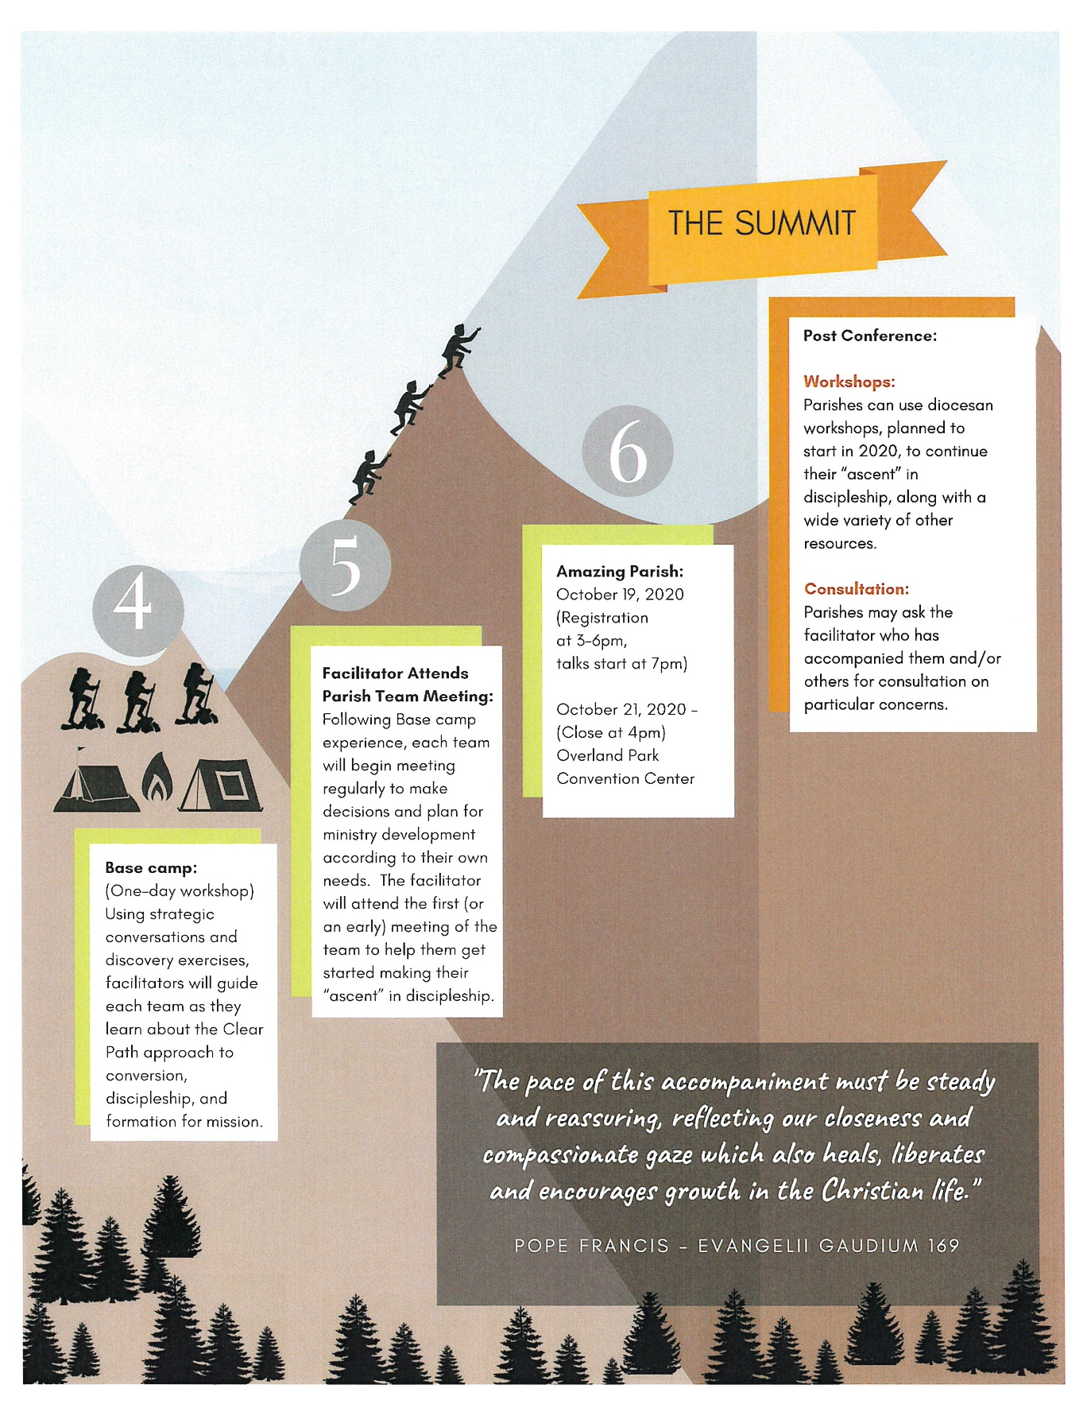
Notes:
[Click the animation once] We are located here. We are at the Parish Team Meeting to prepare your team for the next steps. This evening we will help you get started with a meeting format and some basic skills for making the most of your meetings.

Slide 4
Starting Your Climb
Easy to use Meeting format
Overcoming “near-termism”
Discernment
Continuing on the Clear path

Slide 5
Starting Your Climb Part #1
Easy to use Meeting format

Slide 6
Roles
Meeting facilitator (pastor or other?)
Minutes keeper (internal)
Communication with parish (external)

Slide 7
Meeting format
Prayer
List issues to discuss and discern
Prioritize, then discuss
Clearly define decisions and who will do what
Define how you will communicate decisions

Slide 8
Staying on the path…
Some topics can derail a meeting because they require…
Research to know enough to make an informed decision
Preparation for the discussion (it will take more than a few minutes to describe/understand)
More time than you have and need to be postponed for another meeting

Slide 9
Starting Your Climb Part #2
Overcoming “near-termism”
developing the virtues of fortitude and patience
Notes:
“Near-Termism” can cause us to make decisions about evangelization and formation programs based on what we think will show results most quickly. There are a few things that this process will require and among the most important things are the virtues of fortitude and patience. The Clear Path includes solutions that require considering the long-term plan and benefits of Spiritual Multiplication. This means that… [advance slide]

Slide 10
There are no silver bullets.
Do not expect a quick fix.
This will cost you.

Slide 11
Notes:
From Moments of Impact, pg. 147
“In the famous Stanford Marshmallow Experiment, researchers found that the ability of children to delay gratification by choosing to take two marshmallows in twenty minutes rather than one marshmallow now had long-term predictive value. In follow-up studies, preschoolers who were able to wait the extra time had greater self-control and success as adults.
Organizations could learn a lot from these kids. We need more incentives to offset the powerful effects of temporal discounting – not reinforce it – if we want to thrive for years to come.”

Slide 12
Notes:
Play video
Money quote
“If they’re in an environment in which long-term gain is very rare. Well, then it makes perfect sense for them to behave impulsively because that’s going to maximize their reward.”
Discuss (keep it short) – try to draw out the ways in which we make decisions about evangelization (especially programs and strategies) based on the environment “where long-term gain is very rare.”

Slide 13
“If they’re in an environment in which long-term gain is very rare. Well, then it makes perfect sense for them to behave impulsively because that’s going to maximize their reward.”
Notes:
From Moments of Impact, pg. 147
“We need more incentives to offset the powerful effects of temporal discounting – not reinforce it – if we want to thrive for years to come.”

Slide 14
Where do you think near-termism happens in your parish?
Notes:
Invite and facilitate an open discussion about this.
Diocese effort to overcome near-termism: THIS effort to give everyone the same language and shared methods for discipleship and evangelization. We are helping you invest in your parish leaders as a group.

Slide 15
Starting Your Climb Part #3
Clear path creation: Discernment and decision making

Slide 16
Clear Path Process
Base camp
Foundations & Initial Assessment
Discernment
Implementation
Communication
Alignment
Notes:
At Base camp you learned about foundational discipleship concepts AND performed an Initial Assessment - “1. Foundational Principles + Initial Assessment”
Review with them what their take-aways were…
Things we want them to conclude:
If I don’t do something, the Church is in massive decline – I have to do something.
They are inspired
The Great Commission applies to every Christian. Take ownership of the Great Commission
Jesus’ method for evangelization is the method that needs to be used for all of time – I need to change the way I do things
Jesus’ method is the best method. Jesus gives us the model.
Understanding of the chart
People over programs
Clear understanding of what conversion and decision means
THEN COVER
Discernment as a team… what does our parish need now? What should we “plant” and in what order and timing? Discernment is prayerful decision making always keeping an attitude, What is God’s will for discipleship in our parish?

Slide 17
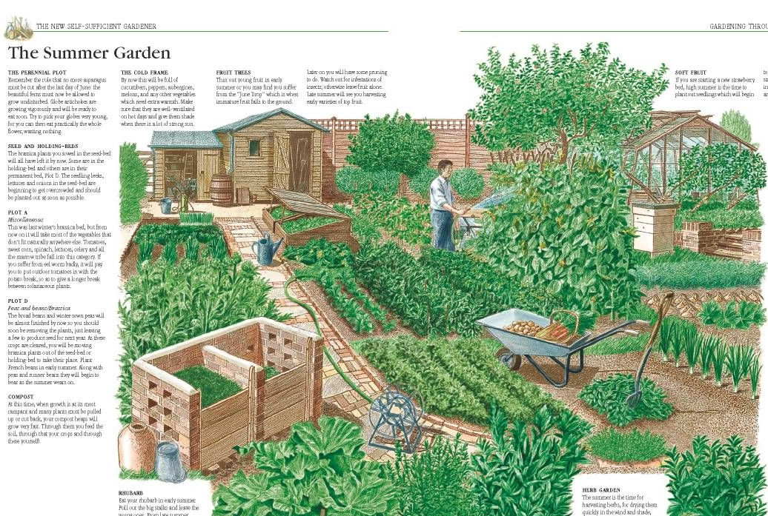
Garden planning
Don’t plant everything at once – just build one section at a time.
Notes:
We are going to fill in the gaps
When finished, the clear path will have all these components:
Access points for people to begin the journey
Clear directions and expectations
Relational connection points between ministries to help people transition and grow
Every ministry in the parish will connect with the clear path in some way
Ministries that run parallel to and support the clear path

Slide 18
Things to Remember
Ask: Which part of the path do we build now?
The goal is simplicity for the sake of conversions
You may eventually pause/prune some ministries
Notes:
Don’t build the whole path all at once
The process should be very simple and easy to understand (for both insiders and outsiders – we will work on this in the communication stage)
Some good ministries may be getting in the way of other ministries becoming excellent

Slide 19
A Clear Path for Discipleship
Notes:
Review CP evaluation of ministries using re-creation of the results from Base camp on a wall hanging chart.

Slide 20
A Clear Path of Discipleship
Relational Outreach
Conversion Greenhouse
Transformational Growth
Missional Teams
Notes:
Ensure understanding of the bridges needed – discuss which section they will work to build first. ASK - Will they create a Conversion Greenhouse? Will they retool an existing program to make it serve as a Conversion Greenhouse? Will they create a new way to equip Growing Disciples to prepare them to become Commissioned Disciples?
Help them prioritize and begin to create a plan for 1-2 years on how they will step-by-step “plant the garden.”

Slide 21
Where to start?
Which bridge comes first? What is the best, first step?
Notes:
Have them practice Healthy Conflict over the answer – click to next slides [Programs Vs. Path – focus on people] [Roger’s Innovation Curve – who is your audience right now?] to facilitate the conversation as appropriate

Slide 22
Where to start?
Programs
VS.
Path
Bible Studies
Women’s Retreat
Exodus 90
Missional Teams
Women’s Group
Saturday Men’s Group
K of C
Adult Formation Catechists
Youth Formation Catechists
Discipleship Groups
Ministry Outreach
First Friday
St. Vincent de Paul
Encounter
Prayer Team
Lenten Fish Fry
CEC
Beta Groups
Parish Men’s Program
Sunday Basketball
Conversion Greenhouses
Fall Family Festival
Theology Night
Donut Sunday
Prayer Chain
Vocations Crucifix
Neighborhood Potluck
Relational Outreach
Knitting Club
LAF
Women’s Group
Alpha

Slide 23
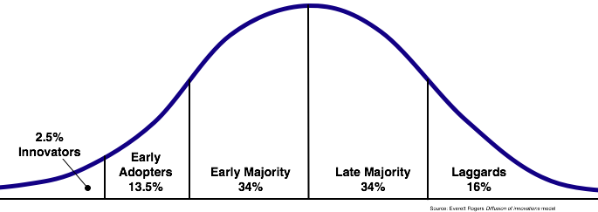
Where to start?
Rogers Innovation Adoption Curve
Notes:
The Roger’s Innovation Adoption Curve describes how new ideas and innovations are accepted and adopted by groups and cultures.
The curve highlights the acceptance through five stages: Innovators, Early Adopters, Early Majority, Late Majority, and Laggards. The stages of Curve shows the willingness to accept risk verses waiting for approval by the masses.
Innovators are the enthusiasts. They want to be the first ones using the latest stuff. They represent a tiny percentage of the market.
Early Adopters are those who enjoy new innovations and are comfortable taking social risk but after they see success from the Innovators. They are trendsetters and are influential.
The Early Majority adopt new innovations only after they’re proven. They are the largest segment of the market.
The Late Majority are cautious about new ideas. They want to see demonstratable results. They also represent a large portion of the market.
Laggards only adopt new ideas if forced…and usually do so kicking and screaming. They are a small audience.
The trick is to get new ideas accepted by Innovators and use their experience to influence Early Adopters. That’s 16%. Then you use Early Adopters to influence the Early Majority. Once you have 25%, you have the potential for culture shift. Here you’re on the path of growth and can start to influence larger portions of your audience. Once the innovation is at 50%, it’s organizational culture. The Late Majority comes in because it’s what everyone else is doing. You may never get the Laggards…but you’ll get some.
We want to apply this to innovation in ministry and parish culture change. You don’t have to convert everyone to these new ideas all at once. At first, all you need to convince is the Innovators, and there will be some. Then use them to influence the Early Adopters. Once you have them, you’re well on your way to culture shift. It may take a while, but if you’re persistent, it will happen.
Remember this: Some will never come on board, but that’s ok.

Slide 24
Starting Your Climb Part #4
Continuing on the Clear path

Slide 25
Clear Path Process
Base camp
Foundations & Initial Assessment
Discernment
Implementation
Communication
Alignment
Notes:
Implementation – who will do what?
Identify members of your team (others in the parish?) to work on what you have decided to do.
Determine clearly who will do what. Get help with implementation (best practices, training, etc.) from the program developers and or your Clear Path facilitator and diocesan staff.
Follow-up on progress, obstacles, needs, success stories, etc. at future team meetings.

Slide 26
Clear Path Process
Base camp
Foundations & Initial Assessment
Discernment
Implementation
Communication
Alignment
Notes:
Communicate with the parish about your plan… not just promotion of each thing.
Communicate the vision… stories of success, your overall plan, etc. Don’t stop communicating once you’ve gotten started.
Tell us about your Clear Path progress.

Slide 27
Clear Path Process
Base camp
Foundations & Initial Assessment
Discernment
Implementation
Communication
Alignment
Notes:
Evaluate your progress at least annually as part of your team meetings. Staying on the right path will likely require that you exercise patience, but it will also require recognizing when something is not leading to the fruitfulness that you hope for. Remember the “Marshmallow Experiment.” Don’t make decisions that are too much based on a mindset of scarcity or impatience.

Slide 28
Going forward (recap)
Easy to use Meeting format
Overcoming “near-termism”
Discernment
Continuing on the Clear path

Slide 29
Going forward (recap)
Meeting Frequency, time, place

Slide 30
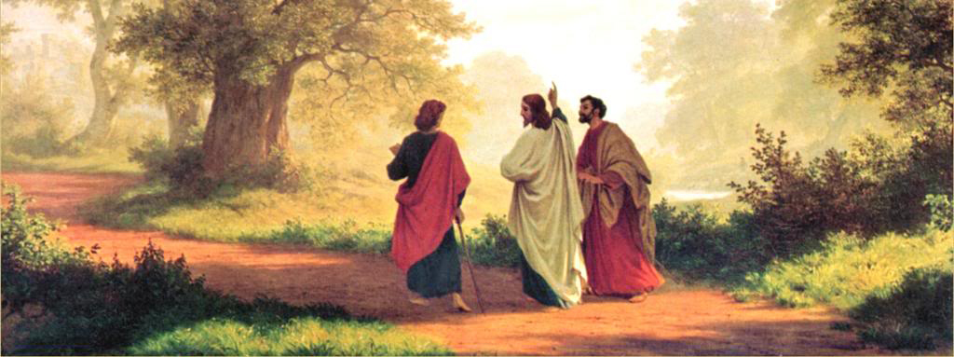
Prayer
Notes:
Prayer – close the meeting with a Glory Be

