Slide 1
Base Camp, Part 3
The method of Jesus

Slide 2
The Method of Jesus
Jesus Gives us a model for Evangelization, and it begins with you and me

Slide 3
Jesus
Notes:
How did Jesus do it?
Well, certainly he spoke to and taught large groups of people…and you will too. You have to get the message out far and wide to attract interested people. However, were the crowds his target? Did he tell them everything?

Slide 4
Jesus
Peter, James & John
Notes:
No, he didn’t. He invested heavily in a small group of people. He poured everything he had into them. He taught them when the crowds went away. He answered their questions. He lived with them. They observed all his habits and his way of life. And, they learned to be like him.
There were the most trusted inner circle of three: Peter, James, and John. They knew more of him than anyone.

Slide 5
Jesus
Peter, James & John
The Twelve
Notes:
And there were the other nine that made up the Twelve. They also lived and worked with Jesus. They were apprentices. They learned by doing, were observed by Jesus, and then further taught…their skills refined.
Jesus’ whole earthly ministry was really the Twelve. They were the plan. He didn’t have any backup. No second string apostles waiting in case these failed. He put his trust and hope in them, so they had to be ready. They would have to run things alone once he was gone. Of course, they had the Holy Spirit…and so will you!

Slide 6
Jesus
Peter, James & John
The Twelve
The 72
Notes:
Then there were the 72. Also disciples and mission partners, but not in the same way as the Twelve. They knew Jesus and had instruction from him, but probably had more contact with the Twelve. They had to. Jesus couldn’t spend that much individual time with 72 people.
This is called spiritual multiplication. Inventing deeply in a small group of people to the point of replicating yourself, and your ministerial abilities, in them. Then setting them off to go and do the same. Spiritual multiplication is the way Jesus did it. He trained the apostles and they did it too. And, from those 12, the whole world was converted.
Three people doesn’t seem like enough! How can it work? You have so many people to reach. How can you ignore them and only concentrate on three? Let’s take a look at the power of spiritual multiplication.

Slide 7
Super-Evangelist vs. Spiritual Multiplier
Year # | Super-Evangelist | Spiritual Multiplier | Diocese Reference
1 | 10,000 | 1
2 | 20,000 | 4 | You + 3 Others
3 | 30,000 | 13
4 | 40,000 | 40 | Leaders of Parish Groups
5 | 50,000 | 121
6 | 60,000 | 364 | Rural Parish
7 | 70,000 | 1,093
8 | 80,000 | 3,280 | Midsize Urban Parish
9 | 90,000 | 9,841
10 | 100,000 | 29,524 | City the size of Liberty, MO
11 | 110,000 | 88,573
12 | 120,000 | 265,720
13 | 130,000 | 797,161
14 | 140,000 | 2,391,494 | Almost every person in the KC Metro
Notes:
The Super-Evangelist barely outpaces our average population growth.
It would take the super evangelist approximately 275 years to evangelize the entire diocese.
But, the spiritual multiplier, even factoring for population growth, would still be able to evangelize the entire diocese by the 14th year.
Here’s a chart comparing the evangelistic impact of a large group approach to spiritual multiplication. It’s a bit exaggerated, but it makes the point.
The Super-Evangelist preaches to large groups and converts 10,000 people a year. Think of a Billy Graham. But the formation he gives is shallow. He can only give a small amount of time to so many people. Consequently, every year there’s 10,000 more Christians, but they never convert any others.
The Spiritual Multiplier only converts 3 in his first year of work. However, he invests in them deeply and teaches them to do the same with others. Now those three go on to convert three of their own so at the end of year 3 there’s 13. Not promising numbers compared to the 30,000 of the Super-Evangelist. But look how things begin to change in year 11. That’s because the numbers of the Spiritual Multiplier compound. The growth is exponential.
Besides, how many Super-Evangelists are there really? In the Church today perhaps Bishop Robert Barron could claim numbers like that, but few others. However, everyone is capable of finding three people to influence in their lifetime.
The Super-Evangelist barely outpaces our average population growth. It would take the him approximately 275 years to evangelize the entire Archdiocese. But, the spiritual multiplier, even factoring for population growth, would still be able to evangelize the entire Archdiocese by the 14th year. And, that’s only from one year’s investment. He could make more spiritual multipliers in subsequent years. But if he couldn’t continue, his work would go on in the ministries of others. His spiritual grandchildren are going strong long after stops.

Slide 8
2 Timothy 2:2
“What you heard from me in the presence of many witnesses entrust to faithful people who will be able to teach others also.”
Paul
Timothy
Epaphras
Titus
Notes:
This concept is communicated by St. Paul in 2 Timothy 2:2. Paul exhorts Timothy to entrust what he has heard to faithful people who can in turn do the same with others. Paul trained Timothy to replicate his ministry. From the New Testament, it seems like there were only a few. Timothy, Titus, Epaphras, Aquilla and Pricilla…maybe a few others. By investing everything, by pouring himself out into those few, Paul is counting reaching the Masses he will never know or even see.
With this strategy, you’re always thinking of the next generation. Yes, those in front of you, but also who will be in front of them. Those unknown, future generations you will never see, they are your responsibility too.

Slide 10
A “Clear Path for Discipleship”
Facilitating Movement and Growth

Slide 11
Programs
With so many different programs, how do people know what’s right for them?
Bible Studies
Women’s Retreat
Exodus 90
Women’s Group
Saturday Men’s Group
K of C
Adult Formation Catechists
Youth Formation Catechists
Ministry Outreach
First Friday
St. Vincent de Paul
Encounter
Prayer Team
Lenten Fish Fry
CEC
Beta Groups
Parish Men’s Program
Sunday Basketball
Fall Family Festival
Theology Night
Donut Sunday
Prayer Chain
Vocations Crucifix
Neighborhood Potluck
Knitting Club
LAF
Women’s Group
Alpha
Notes:
Say: Most parishes look like this. Lots of activities, ministries, and events.
We’re conditioned to think that giving people tons of choices is best option. That way, there’s something for everyone to choose what they like.
However, studies show that’s not the case.

Slide 12
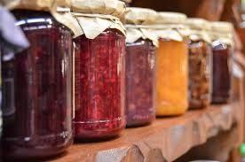
Jam and Decision Paralysis
Notes:
A Stanford psychologist went to a supermarket on an average day and set up a table with 24 different kinds of gourmet jam. If you sampled you got a $1 coupon off the price.
On another day in another market, they set up the same display with 6 kinds of jam. Guess which one led to more sales?
The large display attracted more interest, however people were 10 times more likely to actually buy from the small display. What’s more, other studies have shown that lots of choices actually decrease customer satisfaction after the purchase is made. That’s because people wonder if they made the right decision.
You see the same thing with usability studies on websites. People navigate slower on sites where the top menu has too many options. You’ve seen the ones where all the links drop down at the same time, right? That doesn’t work as well as the ones where there’s a small number of initial choices, three or four, that lead more options.
We all like having choices. It’s looks great. However, choice overload leads to decision paralysis and overall dissatisfaction.

Slide 13
A Clear Path for Discipleship
Notes:
So, what if, instead of a big jumble of offerings, we set up a clear path that identified where people were at in their spiritual journey and what kind of ministry they needed to grow?

Slide 14
Relational Outreach
Conversion Greenhouse
Notes:
And what if, understanding the realities of these stages and what was needed for each one of them [Click] …
… we set up ministries specializing in Relational Outreach where people in these first stages could build bonds of trust with Catholics and get initial questions about the Church answered. [Click]
Then, when they were ready to learn more, they could be moved on to a ministry that would proclaim the Gospel and invite them to make to decision. We call those Conversion Greenhouses. [Click to next slide]

Slide 15
Transformational Growth
Missional Teams
Notes:
Once they made the decision to join the Church, they would enter a period of Transformational Growth. Here, they would join small groups where they could learn how to live as Christians, grow in relationship with God, and come to realize their call to give to others. [Click]
Finally, when they decide to help others, they would be mentored and supported in Missional Teams where they could be taught how to evangelize and work in the other ministry areas.

Slide 16
A Clear Path of Discipleship
Relational Outreach
Conversion Greenhouse
Transformational Growth
Missional Teams
Notes:
Each ministry category relates to people in a different way…the way they need at the time. Can you see how you can’t have one ministry to meet every need?
With this kind of structure, everyone understands where they belong, what kind of ministry they need, and where to go next if they want to progress.

Slide 17
Parish Fish Fry
Alpha
Notes:
Say: Let’s see what this could look like in real life. [Click for animation]
What if, at the Fish Fry, there was a team of people trained to have intentional conversations about faith mingling around in the crowd. They would know the left side of the chart and be equipped to make connections with people on the margins perhaps inviting them to more. [Click for animation]
When they were ready, they could take part in an ALPHA workshop the parish has periodically. ALPHA is an 8-week course that evangelizes people and invites them to make a decision for Christ. That would be an example of a Conversion Greenhouse.
Review Conversion Greenhouse handout

Slide 18
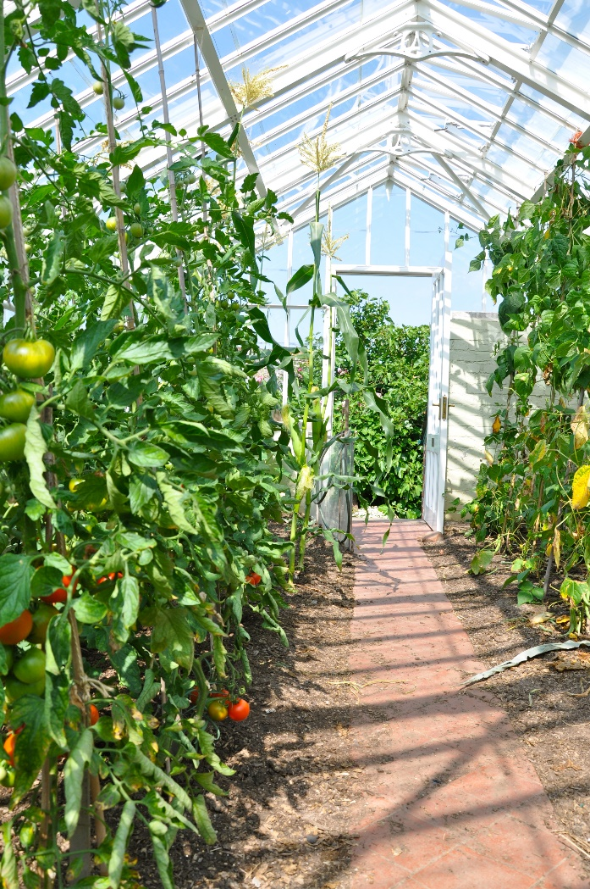
Characteristics of an Effective Conversion Greenhouse
Highly Kerygmatic
Conversion-Oriented
Rooted in Scripture
Small Group Context
Mentorship of Individuals
Notes:
Review handout
It’s extremely important to understand that a greenhouse must have all of these characteristics to be effective. There are only a few that meet all these criteria. We have several listed on the handout, and there are a few others we’ve identified.
This is the key driver of the whole process. Without this piece, the path won’t work. It’s vital that you choose at least one option from the list if you want this to be effective.

Slide 19
Small Group Studies
Missional Teams
Notes:
To see any growth in the Beginning and Growing Disciple thresholds, [Click for animation] …
… you need people to be in small groups. In part these can be Bible studies like Great Adventure, but there must also be groups devoted to spirituality—teaching people to pray, live a sacramental life, and grow in relationship with Jesus. [Click for animation]
Missional teams are the fruit of this process… advance slide!

Slide 20
2 Timothy 2:2
Missional Teams – group made up of a Disciple-Maker and those he is discipling through the stages. When they become Disciple-Makers the generation progresses.
Paul
Timothy
Epaphras
Titus
Notes:
A Missional Team is a group of people that supports each other in mission.
They are lead by a Paul, someone who has experience and can be a guide. The Timothy is mentored by Paul while he, in turn, trains and supports his own group of disciple-makers who are also ministering to individuals or small groups who are on the path.
Everyone in this stage must have a Paul and have their own Timothy who can also raise up other leaders. That’s how the process continues on in spiritual multiplication.

Slide 21
A Clear Path of Discipleship
Relational Outreach
Conversion Greenhouse
Transformational Growth
Missional Teams
Notes:
To make sure people progress, there are “relational bridges” that move people along the path.
This is what the complete path looks like. Every threshold has a targeted ministry designed to meet the needs of those people. Every ministry contributes to the path. It reaches the people in that threshold and intentionally moves them to the next. No wasted energy or resources.

Slide 22
Programs
VS.
Path
Bible Studies
Women’s Retreat
Exodus 90
Missional Teams
Women’s Group
Saturday Men’s Group
K of C
Adult Formation Catechists
Youth Formation Catechists
Discipleship Groups
Ministry Outreach
First Friday
St. Vincent de Paul
Encounter
Prayer Team
Lenten Fish Fry
CEC
Beta Groups
Parish Men’s Program
Sunday Basketball
Conversion Greenhouses
Fall Family Festival
Theology Night
Donut Sunday
Prayer Chain
Vocations Crucifix
Neighborhood Potluck
Relational Outreach
Knitting Club
LAF
Women’s Group
Alpha
Notes:
Four choices, tailored to meet specific needs, each with a clearly defined next step.
See how this is much easer to navigate compared to the multitude of choices we saw in the beginning?

Slide 23
Clear Path Assessment
Notes:
Now we start to tie everything we’ve talked about together.

Slide 24
What is our mission?
To make Missionary Disciples.
What is at stake if we fail in our mission?
Notes:
What is our mission? To make missionary disciples.
If we fail, we’ll continue the downward trend we saw this morning. We’ll enter the decline phase on the S-curve and have a harder and harder time pulling out of it. Now is the time to act!
Like Pope Francis said, we need to have all the parish energies contributing to the mission of evangelization. So, you need to design your clear path.

Slide 25
Planning: Does the order/sequence matter?
People (why) – transformed lives
Process (how) – clear path
Programs (what) – concrete initiatives
Notes:
As you’re planning, you have to keep in mind the sequence or priority of your choices. The progression is Why, How, What. You always start with why. [Click for animation]
People are your why. People having their lives transformed by the Gospel. It always starts with the people. [Click for animation]
How are you going to do that? What is your process for achieving this? It’s the Clear Path. [Click for animation]
Last comes the What. Those are the programs you offer, the concrete initiatives that minister to people and move them along the path.
Why, How, What. You have to plan in that order. What happens when this is inverted? You have the Ministry Fair Model. That’s where you start with the programs, then we develop a process for filling the programs called a ministry fair, where people can join our programs. How does that lead to transformed lives? You’re just hoping. Sometimes it does, but it’s not intentional.
Why, How, What. People over programs. That’s one of the mantras of discipleship ministry. You always start with why.

Slide 26
Clear Path Process
Foundations & Initial Assessment
Discernment
Implementation
Communication
Alignment
Notes:
So, there’s 5 steps to the whole clear path process. [Click to show each one. Read them as they appear. Then click one last time to highlight the first one]
Today is just the first one, Foundations & Initial Assessment. We’ve just been through all the foundational principles of the Clear Path. Now, we’re going to do the initial assessment of your parish programs. I just want to re-iterate, this is just the beginning. There are a lot more pieces to making this effective than just getting your programs lined up. That’s the foundational piece, but it’s only one piece.

Slide 27
Mapping Your Clear Path
Where are we at Now?
Notes:
Before you can know which direction to go, you have to know where you are. That’s what we’re going to do now.

Slide 28
Notes:
We’ll start off this next section with a video.

Slide 29
A Clear Path for Discipleship
Relational Outreach
Conversion Engine
Discipleship Groups
Missional Teams
Notes:
Now your going to evaluate all your parish programs and to see where they fit on the Clear Path. Your focus will be on fitting them into the 4 main areas that reach people at different thresholds.

Slide 30
Evaluation questions
Who is this ministry designed to serve (i.e., which thresholds)?
How does this ministry intentionally foster spiritual growth?
Notes:
When evaluating, first ask yourself, “Who is this ministry designed to serve (i.e., which thresholds does it minister to)?
Remember, start with why – the people come first
Next, the “how.” Consider how the ministry intentionally fosters spiritual growth. Example: Does it build relationships of trust? Does it preach the gospel and invite decision for Christ?

Slide 31
Stage in Clear Path | “We exist to…”
Relational Outreach | Witness to the joy of the Gospel by building friendships with people far from God
Conversion Greenhouse | Bring people to an encounter with Jesus that leads to conversion of heart
Discipleship Groups | Build up disciples in the knowledge and habits of the Catholic faith
Missional Teams | Evangelize people at specific thresholds in a particular context
Notes:
For a ministry to fit into one of these stages, it has to answer the question, “We exist to…”
This is what it does as it exists right now. This is not what it could do or what it has the potential to do if we tweaked it. Who is it designed to serve and what is it designed to do right now.
Remember, to be an effective Conversion Greenhouse, it has to possess all the characteristics on the handout we gave you earlier. Be very exacting on this one. It’s important to get these right.
If it doesn’t actually do these things, it doesn’t belong in these stages. Don’t worry, it’s perfectly fine to have a lot of things that don’t fit here.

Slide 32
Other Categories | “We exist to…”
Leadership & Maintenance (e.g., Pastoral Council, Liturgical Ministry, Grounds & Facilities) | Direct and oversee the operations of the parish
Social & Other (e.g., Knitting Club, Men’s Club, Fish Fry) | Build social connections around a common interest
Corporal Works of Mercy (e.g., Soup Kitchen, Clothing Drive) | Provide for the material needs of the poor
Notes:
If you do have ministries that don’t fit (and you will), evaluate if they fit into any of these categories.
Many things of the things parishes do have only a supporting role in evangelization. They’re still important, but they don’t fit on the path.

Slide 33
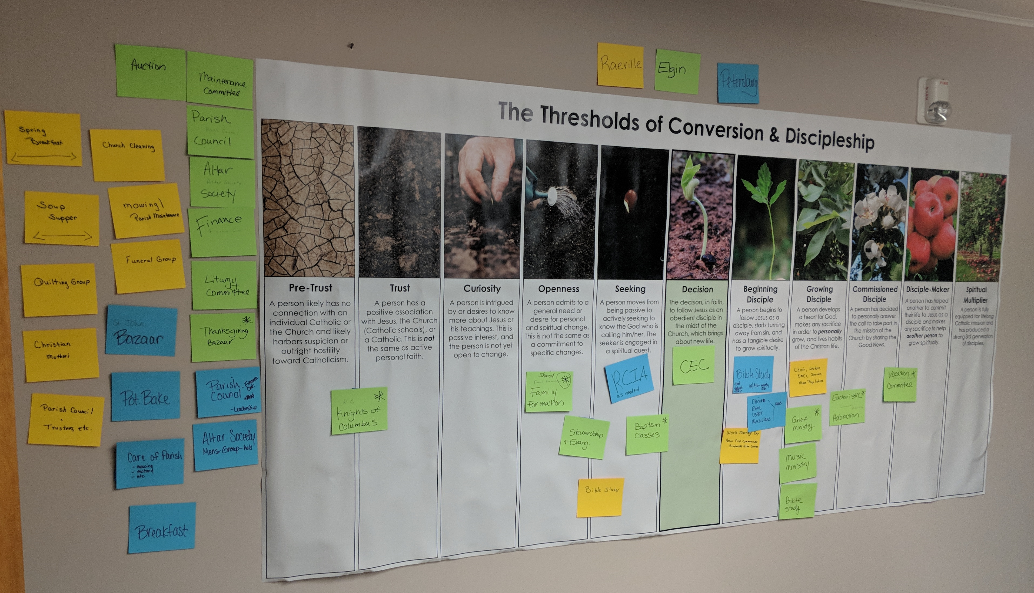
Clear Path Assessment
Notes:
Give everyone parish ministries individual assessment handout.
Say: We’re going to give you 10 minutes to evaluate this list of ministries individually, then as a team. Go through the list applying the evaluation questions and check which category it falls under. If it doesn’t fit, don’t force it. The goal is to get an honest assessment of where your parish is starting from, not to fill in all the spots…not yet anyway.
You don’t need to spend too much time on this. You’ll evaluate these again as a team in a few minutes.

Slide 34
What do you see?
Where are the gaps in the process?
Are there any duplicated efforts?
Notes:
Where are there gaps?
Where are there duplicated efforts?
Where are people failing to transition and grow because the steps are too big?

Slide 35
Things to Remember
Ask: Which part of the path do we build now?
The goal is simplicity for the sake of conversions
You may eventually pause/prune some ministries
Notes:
Don’t build the whole path all at once
The process should be very simple and easy to understand (for both insiders and outsiders – we will work on this in the communication stage)
Some good ministries may be getting in the way of other ministries becoming excellent

Slide 36
Your ONE big take-away…
Notes:
Give them 3 minutes to capture their ONE big take-away.

Slide 37
Prayer

Slide 38
Feedback & Next Steps

Slide 39
Next Steps
Prayer with Scripture: Missionary Discipleship – what is the life that the Lord is calling us to? Scripture passages for prayer on missionary discipleship.
Schedule facilitator to visit your “Parish Team Meeting”
Notes:
Spend a significant time in prayer and reading Scripture. Read about discipleship. Allow God to reveal what a disciple at your parish should look like. As a Leadership Team, have open discussions about what kind of disciples God is calling you to make.

Slide 40
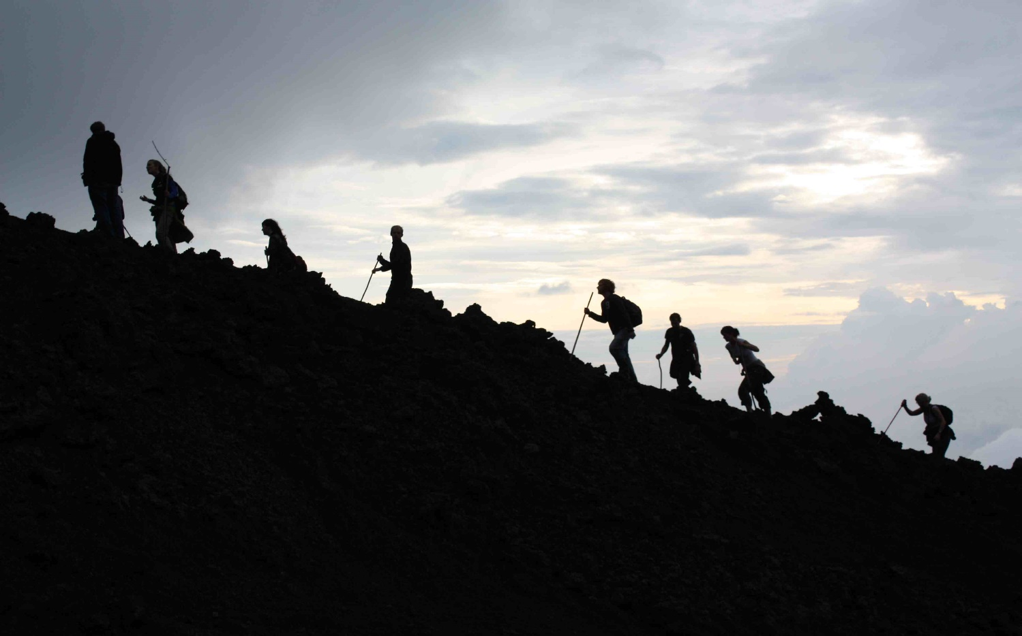
Survey

