Slide 1
Base Camp, Part 2
Evangelization is both easier and harder than you think

Slide 2
The Challenge of Culture Change
Doing Change well
Notes:
This is going to require changes (on our part)—but it can be done!
Essentially this is a conversion because it will require a mindset change, and we may have to change some of the ways we do things.

Slide 3
It is necessary to awaken again in believers a full relationship with Christ, mankind’s only Savior. Only from a personal relationship with Jesus can an effective evangelization develop. Pope St. John Paul II
Notes:
Read this and offer commentary.

Slide 4
In your heart you know that it is not the same to live without him; what you have come to realize, what has helped you to live and given you hope, is what you also need to communicate to others. Our falling short of perfection should be no excuse; on the contrary, mission is a constant stimulus not to remain mired in mediocrity but to continue growing. Pope Francis, The Joy of the Gospel, #121
Notes:
Have them read silently to themselves.

Slide 5
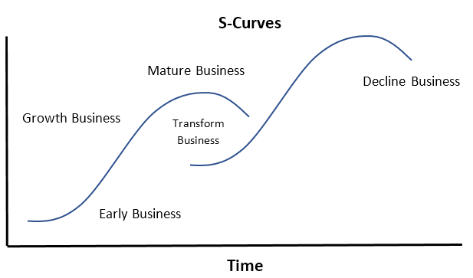
Notes:
Here’s an example of doing change well.
Everything has a natural rhythm: it starts out, grows, and then declines. You see this pattern in nature, political systems, businesses, and organizations. It’s illustrated visually using “S-curves”. Sooner or later, all approaches and strategies run out of room to grow. Then decline sets in. The question is not how to defend against it, but knowing this, to manage it.
Successful companies do something called “jumping the S-curve.” When a business nears maturity, but is still profitable, it begins refreshing existing products or launching all-new products and/or disruptive technologies (think Uber or AirBnB). This transformation takes time to get going, but it ramps up as the mature methods are still working. As the old declines, the new enters the growth stage and takes over. In practice, long-standing businesses are a made up of numerous S-curves that ride the waves of growth and decline.
In our situation, we’re not talking about changing the things that can’t change, like doctrine. We’re talking about things like methods, delivery, and the way we communicate. Think of the Pope Francis quote, “customs, ways of doing things, times and schedules, language and structures.”
This leads to next slide…

Slide 6
Only by starting with conversion, and therefore by making allowance for the interior disposition of “whoever believes,” can catechesis…fulfill it’s proper task of education in the faith…Catechetical renewal should be based thus on prior missionary evangelization. General Directory for Catechesis #62
Notes:
For example, take a look at this from the General Directory for Catechesis published in the late 90’s. This principle is becoming more and more accepted now, but do we have anything that looks like this? I don’t think so.
The important take away here is that ministry effectiveness will decline, and new, more effective innovations are always coming out. We need to integrate the new within the old. We can’t doggedly hold on to the old even after it declines. We must iterate and evolve.

Slide 7
Notes:
Rogers Innovation Adoption Video

Slide 8
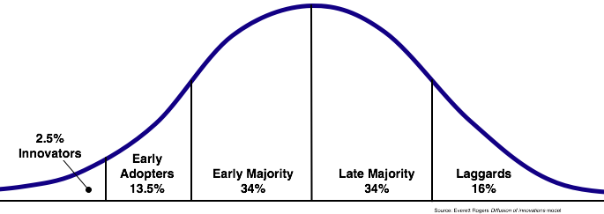
Rogers Innovation Adoption Curve
Notes:
So, the Roger’s Innovation Adoption Curve describes how new ideas and innovations are accepted and adopted by groups and cultures.
The trick is to get new ideas accepted by Innovators and use their experience to influence Early Adopters. That’s 16%. Then you use Early Adopters to influence the Early Majority. Once you have 25%, you have the potential for culture shift. Here you’re on the path of growth and can start to influence larger portions of your audience. Once the innovation is at 50%, it’s organizational culture. The Late Majority comes in because it’s what everyone else is doing. You may never get the Laggards…but you’ll get some.
We want to apply this to innovation in ministry and parish culture change. You don’t have to convert everyone to these new ideas all at once. At first, all you need to convince is the Innovators. There will definitely be some. Then use them to influence the Early Adopters. Once you have them, you’re well on your way to culture shift. It may take a while, but if you’re persistent, it will happen.

Slide 9
The Process of Evangelization
Thresholds of Conversion
Notes:
So now we come to the process for evangelization.

Slide 10
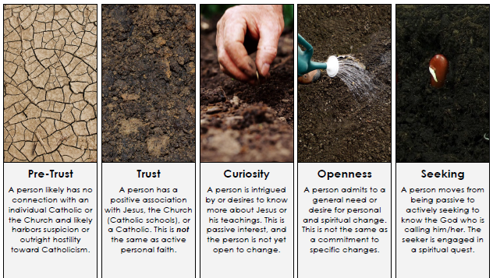
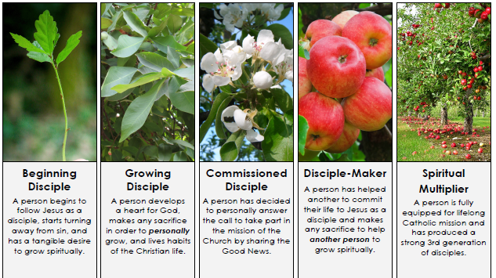
The Thresholds of Conversion & Discipleship
Notes:
These are the Thresholds of Conversion and Discipleship.
It’s a combination of two resources written in everyday language. It focuses on the journey of the individual because evangelization happens person to person, one person at a time.
This chart gives meaning to the term “meet them where they’re at…and take them where God wants them to be”
Think of this chart as a continuum moving from left to right, increasing in: trust in the Lord, love, relationship with Jesus, activity/personal initiative, and involvement in the community. Decision is the point of movement from passive to active disposition. Decision is the hinge.

Slide 11
Pre-Trust
Trust
Curiosity
Openness
Seeking
Decision
Notes:
Here’s the left side of the chart leading to Decision.
Redo with the language on the chart.
Make individual slides for each one with the wording on it
Pre-Trust: is when someone has no connection with the Catholic Church and might even have hostility or suspicion. They don’t know any Catholics and probably all they know about the Church is what they hear in the media.
Trust: This person is outside the Church but has a positive association with Catholics or a Catholic organization.
Curiosity: A person wants to know more about Catholicism but is not yet ready to change.
Openness: Here someone wants some kind of change but it doesn’t necessarily involve the Catholic Church.
Seeking: Now it finally moves from passive to active. This person is on a spiritual quest and goes looking for answers. The majority of people who show up at the parish wanting to learn more about the Church and who end up joining the RCIA are probably in this stage. Notice, there’s a whole lot that has to happen on in this journey before that can take place. All the other stages were somehow accomplished either by friends/family members, EWTN, blog posts, or YouTube videos.
Decision: This side ends with the decision to follow Jesus as a disciple in the Catholic Church.

Slide 12
RCIA Process comparison
Rite of Acceptance
Initiation
Inquiry/ Pre-Cat
Purification…
Mystagogy
Notes:
Now, let’s briefly compare the Thresholds of Conversion and Discipleship with the stages of the RCIA process.
[Click] The people and their needs in the Inquiry and Pre-catechumenate stage corresponds to the left side of the chart.
[Click] The Rite of Acceptance corresponds to the moment of decision and commitment, initially made at the Rite of Acceptance and completed at full Initiation – the reception of the Sacraments at Easter (or for the already baptized, perhaps at another time).
[Click] The Period of Purification and Enlightenment corresponds to the beginning disciple, who has begun to live as a disciple and more and more seeks to walk with Jesus Christ in every part of their life.
[Click] At Initiation we complete our decision for Christ and commitment to his mission and that of the Church and are strengthened for this mission through our reception of Confirmation and Holy Eucharist. Our new identity as a Child of God also means that we take on the identity of the Church – to evangelize… to be on mission… to be missionary disciples.
[Click] the period of Mystagogy provides an opportunity for us to deepen our receptivity to the graces of the Sacraments and our commitment to our identity as missionary disciples. Moving forward beyond the RCIA process specifically, the Church ought to encourage the baptized to take up their full stature as missionary disciples and equip them to become disciple-makers.

Slide 13
General Directory for Catechesis #56 Describing the process of continuing conversion in relation to the RCIA
Interest in the Gospel
As a result of its first proclamation, an interest in the Gospel [is born], yet without any firm decision.
Conversion
[This] requires a period of searching to be transformed into a firm option.
Profession of faith
Abandonment of self to Jesus Christ arouses in believers a desire to know him more profoundly…
Journeying towards perfection
The profession of baptismal faith is the foundation of a spiritual building which is destined to grow.
Notes:
Read the text on the screen (only).
The full text of GDC 56 is provided below for context.
The process of continuing conversion
56. Faith is a gift destined to grow in the hearts of believers. (156) Adhering to Jesus Christ, in fact, sets in motion a process of continuing conversion, which lasts for the whole of life. (157) He who comes to faith is like a new born child, (158) who, little by little, will grow and change into an adult, tending towards the state of the "perfect man", (159) and to maturity in the fullness of Christ. From a theological viewpoint, several important moments can be identified in the process of faith and conversion:
a) Interest in the Gospel. The first moment is one in which, in the heart of the non believer or of the indifferent or of those who practice other religions, there is born, as a result of its first proclamation, an interest in the Gospel, yet without any firm decision. This first movement of the human spirit towards faith, which is already a fruit of grace, is identified by different terms: "propensity for the faith", (160) "evangelic preparation", (161) inclination to believe, "religious quest". (162) The Church calls those who show such concern "sympathizers". (163)
b) Conversion. This first moment of interest in the Gospel requires a period of searching (164) to be transformed into a firm option. The option for faith must be a considered and mature one. Such searching, guided by the Holy Spirit and the proclamation of the Kerygma, prepares the way for conversion which is certainly "initial", (165) but brings with it adherence to Christ and the will to walk in his footsteps. This "fundamental option" is the basis for the whole Christian life of the Lord's disciple. (166)
c) Profession of faith. Abandonment of self to Jesus Christ arouses in believers a desire to know him more profoundly and to identify with him. Catechesis initiates them in knowledge of faith and apprenticeship in the Christian life, thereby promoting a spiritual journey which brings about a "progressive change in outlook and morals". (167) This is achieved in sacrifices and in challenges, as well as in the joys which God gives in abundance. The disciple of Jesus Christ is then ready to make an explicit, living and fruitful profession of faith. (168)
d) Journeying towards perfection. The basic maturity which gives rise to the profession of faith is not the final point in the process of continuing conversion. The profession of baptismal faith is but the foundation of a spiritual building which is destined to grow. The baptized, moved always by the Spirit, nourished by the sacraments, by prayer and by the practise of charity, and assisted by multiple forms of ongoing education in the faith, seeks to realize the desire of Christ: "Be perfect as your heavenly Father is perfect". (169) This is the call to the fullness of perfection which is addressed to all the baptized.

Slide 14
Game Time

Slide 15
Instructions:
Disburse cards among the people at your table.
Take turns reading one card out loud.
Discuss as a group and place the card at a threshold.
Notes:
These cards describe people who fit in these left side categories.
Take turns reading the cards out loud.
Discuss the profiles on the cards as a group and place the card at a threshold.

Slide 17
Pre-Trust
Trust
Curiosity
Openness
Seeking
Decision
John
Charlie
Robert
Paula
Teresa
Megan
Laura
Karen
Notes:
Can you see that people in these early thresholds don’t care how much you know/ They want to know how much you care.
Example of misguided evangelization – giving Catholic books to those who aren’t curious. At what stage would it be appropriate to suggest a book to someone?

Slide 18
Pre-Trust
Trust
Curiosity
Openness
Seeking
Decision
Paula
Megan
Notes:
I want to draw your attention to Paula and Megan.
What are the characteristics of Paula? Often people in the openness category are hurting in some way. They are dissatisfied with their life and are looking for a change. Pain open a heart to consider new possibilities.
Do you know a Paula? She’s open but not necessarily to Catholicism.
What are the characteristics of Megan? She makes an intentional decision to follow Jesus in response to hearing the Gospel. What would it take to turn a Paula into a Megan?

Slide 19
Notes:
Let’s talk about Decision. This moves the whole process. Everything on the left side is drawn towards Decision and everything on the right side emanates from it.
Pope John Paul II said in Mission of the Redeemer, “All forms of missionary activity are directed to this proclamation…as the hinge on which all evangelization turns.”
(Pope John Paul II, Mission of the Redeemer, 44)
"Evangelization will always contain--as the foundation, center and at the same time the summit of its dynamism--a clear proclamation that, in Jesus Christ...salvation is offered to all people, as a gift of God's grace and mercy."
(Pope Paul VI, Evangelization in the Modern World, 27)
What is this “proclamation”? It’s the kerygma, the core Gospel message.
Add slide--Emphasize the difference between encounter and decision – Fr. M
Also, talk about different experiences with decision and types

Slide 20
Sharing the Good News
Jesus gives us a model of evangelization, and it begins with you and me

Slide 21
“Of course, all of us are called to mature in our work as evangelizers. We want to have better training, a deepening love and a clearer witness to the Gospel…
All of us are called to offer others an explicit witness to the saving love of the Lord, who despite our imperfections offers us his closeness, his word and his strength, and gives meaning to our lives.” Pope Francis, The Joy of the Gospel, #121
Notes:
Have participants read this silently.

Slide 22
The Kerygma is…
“The initial ardent proclamation by which a person is one day overwhelmed and brought to the decision to entrust himself to Jesus Christ by faith.” Pope St. John Paul II, On Catechesis in Our Time, #25
Notes:
What is the Kerygma? Have participants read this silently.

Slide 23
The Good News
The Core Gospel Message
God loves us and made us for relationship with him & others. (John 3:16)
Sin ruins our relationships & isolates us now and for eternity. (Romans 6:23)
Jesus restores our relationship with God by his death and resurrection. (Romans 5:8)
Our response to accept Jesus opens us to life eternal. (Rev. 3:20)
Notes:
Expound on the 4 points

Slide 24
“Even the finest witness will prove ineffective in the long run if it is not explained, justified… and made explicit by a clear and unequivocal proclamation of the Lord Jesus…There is no true evangelization if the name, the teaching, the life, the promises, the kingdom and the mystery of Jesus of Nazareth, the Son of God are not proclaimed.”
Pope Paul VI, Evangelization in the Modern World, #22
Notes:
Have them read silently.
Ask: What must be present for a true evangelization to take place? The proclamation of Jesus.

Slide 25
^{“13} For ‘everyone who calls on the name of the Lord will be saved.’ ¹⁴ But how can they call on him in whom they have not believed? And how can they believe in him of whom they have not heard? And how can they hear without someone to preach? ¹⁵ And how can people preach unless they are sent? As it is written, ‘How beautiful are the feet of those who bring [the] good news!’ … ¹⁷ Thus faith comes from what is heard, and what is heard comes through the word of Christ.”
Romans 10:13-17
Notes:
Have them read silently.
Ask: Faith comes from hearing, what does that require? Someone to bring the good news!

Slide 26
Beginning Disciple
Growing Disciple
Commissioned Disciple
Disciple Maker
Spiritual Multiplier
Notes:
Now let’s look at the right side of the chart.
The Beginning Disciple is just starting to follow Jesus. They want to live as a disciple and grow spiritually but may not be completely out of their old lifestyle.
The Growing Disciple is living the Christian life and will make any sacrifice to grow personally.
Commissioned Disciples have decided to use their gifts and talents in the service of mission.
The Disciple-Maker has actually done it, they’ve led someone to commit to Jesus, and will make any sacrifice to help another grow spiritually.
The Spiritual Multiplier has produced a 3rd generation. That means they’ve led someone to Christ and that disciple has made another disciple.

Slide 27
Notes:
Have them repeat the exercise for the right side.

Slide 28
Beginning Disciple
Growing Disciple
Commissioned Disciple
Disciple Maker
Spiritual Multiplier
Tim
Adam
Nick
Bill
Pam
Mary
Anna

Slide 29
Beginning Disciple
Growing Disciple
Commissioned Disciple
Disciple Maker
Spiritual Multiplier
Adam
Bill
Notes:
Let’s take a closer look at Adam and Bill.
Adam believes in the truth of the Church and wants to learn everything he can. He’ll make any sacrifice to grow personally. Adam is like your model parishioner, right? He goes to everything you offer.
But Bill will make any sacrifice to help another person grow spiritually. Adam is a good guy, but Bill is leaving a legacy. Remember, evangelization happens person to person, one person at a time. Bill is answering the call. He’s proclaiming Christ even when it’s inconvenient. Without Bills, there can be no evangelization. Suddenly, Adam doesn’t seem so model. We need more Bills. How do we get that? By moving more Adams through the threshold to Commissioned Disciple and then Disciple-Maker.
So what do you do when the Bills in our parishes are only at a ratio of 1:168?

Slide 30
Evangelization Strategy
“Raise up gardeners”

Slide 31
How do you turn them (dark) green?
Notes:
We have to “Raise up Gardeners.” Now you know how.

Slide 32
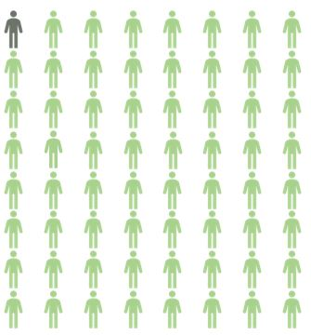
Disciples Equipped to Evangelize
Number attending Mass
1 to 64
Notes:
Using the 2010 U.S. Census data and Diocesan Spiritual Report data… We start out at 1:64.
Ratios: (Mish Disc to total # Catholics)
From here we are at (2010) 1:64
If we raise up 2, ratio decreases to 1:32
If we raise up 10, ratio decreases to 1:6
If we raise up 16, ratio decreases to approximately. 1:4
16 to 64 is 25% of mass-going population for culture shift.

Slide 33
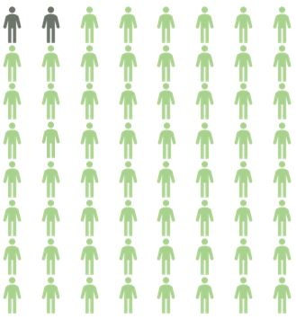
Disciples Equipped to Evangelize
Number attending Mass
1 to 32
Notes:
Using the 2010 U.S. Census data and Diocesan Spiritual Report data… We start out at 1:64.
Ratios: (Mish Disc to total # Catholics)
From here we are at (2010) 1:64
If we raise up 2, ratio decreases to 1:32
If we raise up 10, ratio decreases to 1:6
If we raise up 16, ratio decreases to approximately. 1:4
16 to 64 is 25% of mass-going population for culture shift.

Slide 34
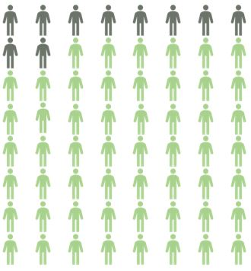
Disciples Equipped to Evangelize
Number attending Mass
1 to 6
Notes:
Using the 2010 U.S. Census data and Diocesan Spiritual Report data… We start out at 1:64.
Ratios: (Mish Disc to total # Catholics)
From here we are at (2010) 1:64
If we raise up 2, ratio decreases to 1:32
If we raise up 10, ratio decreases to 1:6
If we raise up 16, ratio decreases to approximately. 1:4
16 to 64 is 25% of mass-going population for culture shift.

Slide 35
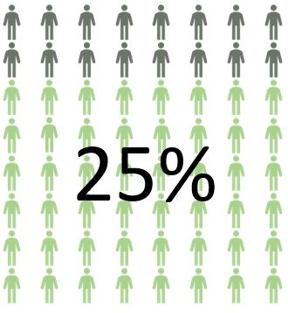
Disciples Equipped to Evangelize
Number attending Mass
1 to 4
Notes:
Using the 2010 U.S. Census data and Diocesan Spiritual Report data… We start out at 1:64.
Ratios: (Mish Disc to total # Catholics)
From here we are at (2010) 1:64
If we raise up 2, ratio decreases to 1:32
If we raise up 10, ratio decreases to 1:6
If we raise up 16, ratio decreases to approximately. 1:4
16 to 64 is 25% of mass-going population for culture shift.
Maryville: 2018 Mass Attendance = 878. 25% is 220.
Stanbury: 2018 Mass Attendance = 258. 25% is 65.

Slide 36
Now… calling to mind this question we asked this morning:
How does it make you feel when you hear that Jesus is calling you to evangelize & make disciples?
How do you feel now? If it’s different, write it down and add it on top of other, previous words.
Notes:
Pair and share
As you’re discussing things, if there’s a word that describes what you’re feeling and thinking, ******write it on a sticky note and put them on the wall ON TOP OF PREVIOUS WORDS.
Draw out from pastor and several other people

