Slide 1
Base Camp, Part 1
Encounter is the key to evangelization

Slide 2
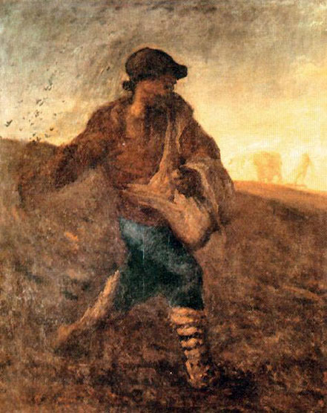
Prayer – Matthew 13:1-9 “…Other seeds fell on good soil and brought forth grain, some a hundredfold, some sixty, some thirty.”
Notes:
Pray, read the ENTIRE scripture passage and pray extemporaneous prayer for the needs of the day. Invoke the Holy Spirit!
Full Scripture
Mt. 13:1-9
[1] That same day Jesus went out of the house and sat beside the sea. [2] And great crowds gathered about him, so that he got into a boat and sat there; and the whole crowd stood on the beach. [3] And he told them many things in parables, saying: "A sower went out to sow. [4] And as he sowed, some seeds fell along the path, and the birds came and devoured them. [5] Other seeds fell on rocky ground, where they had not much soil, and immediately they sprang up, since they had no depth of soil, [6] but when the sun rose they were scorched; and since they had no root they withered away. [7] Other seeds fell upon thorns, and the thorns grew up and choked them. [8] Other seeds fell on good soil and brought forth grain, some a hundredfold, some sixty, some thirty. [9] He who has ears, let him hear."

Slide 3
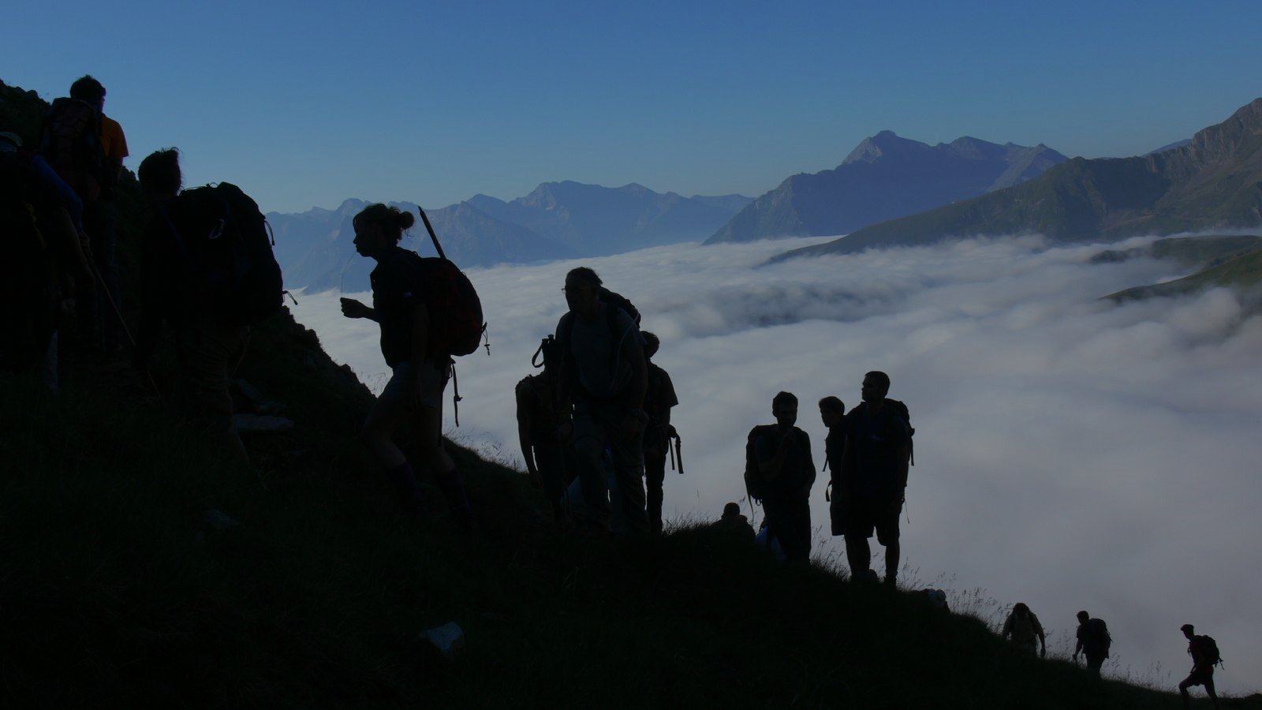
Why are we here?
Notes:
We are here to prepare for Base camp, the one-day workshop that will equip your discipleship team to create a Clear Path for Discipleship for your parish (school, etc.) This evening we are doing the preparation work for the climb.

Slide 4
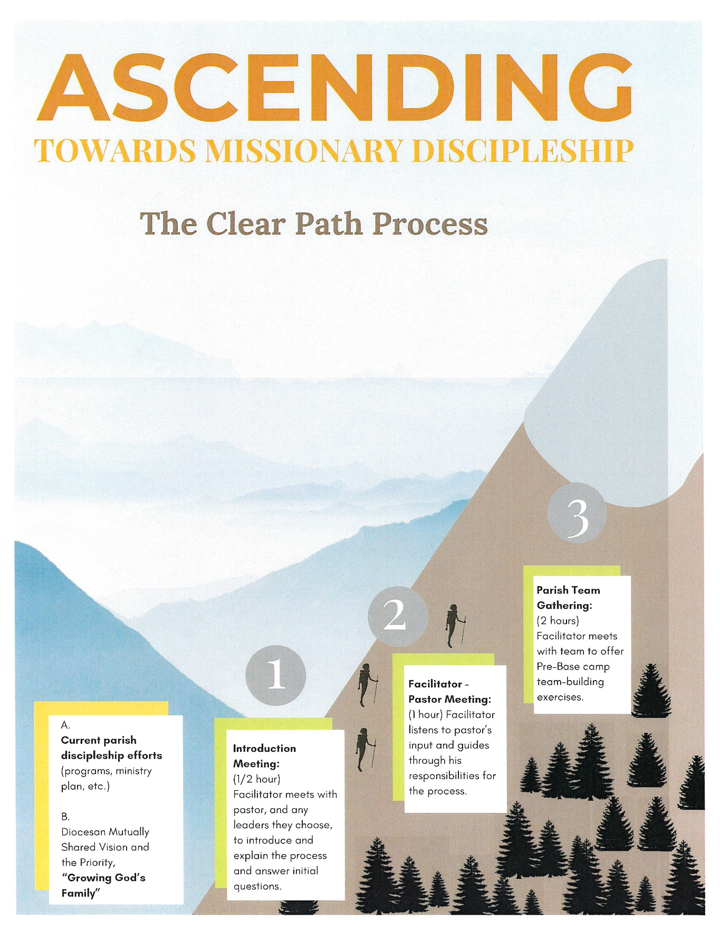
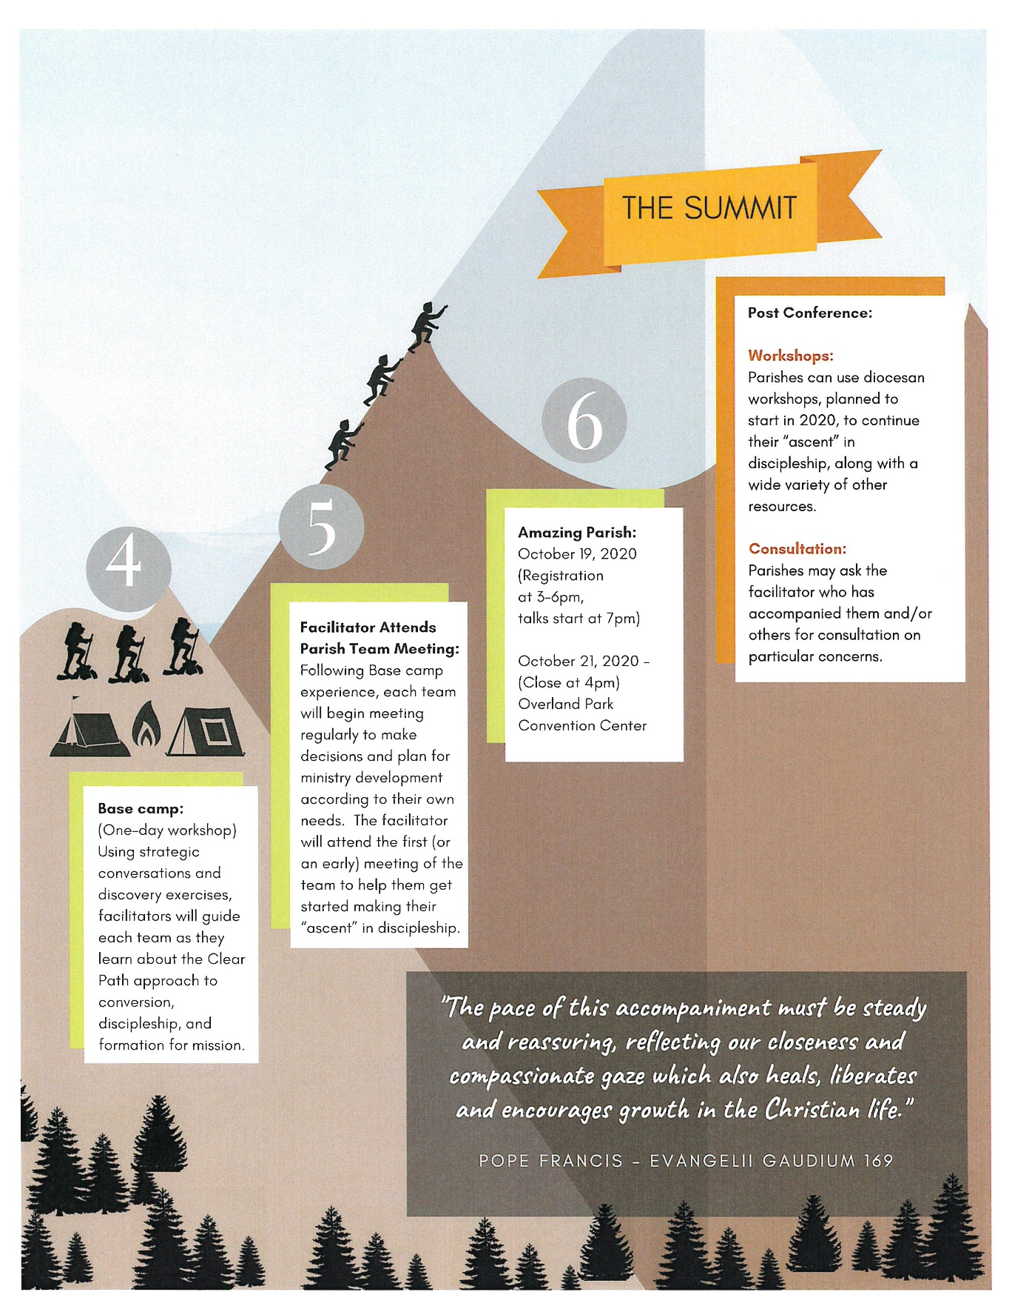
Notes:
[Click the animation once] We are located here—Base camp. This evening we will explore what it means to be a real team and discuss what your team can do to become the best team it can be.

Slide 5
The Mission of the Church

Slide 6
“All power in heaven and on earth has been given to me. ¹⁹ Go, therefore, and make disciples of all nations, baptizing them in the name of the Father, and of the Son, and of the holy Spirit, ²⁰ teaching them to observe all that I have commanded you. And behold, I am with you always, until the end of the age.” Matthew 28:18-20
Notes:
Have participants read passage silently to themselves. You’re looking for short answers here, not discussion. You don’t want to answer this now.
Ask: When does this take place? Right before the Ascension.
What is Jesus’ primary directive? Go make disciples (and baptize and teach).

Slide 7
Evangelizing is in fact the grace and vocation proper to the Church, her deepest identity. She exists in order to evangelize. Pope Paul VI, Evangelization in the Modern World, #14
Notes:
Have participants read passage silently to themselves. Short answers.
Ask: What does the Church exist to do according to Pope Paul VI? Evangelize!
Who is the Church? All of us!

Slide 8
“Every Christian is a missionary to the extent that he or she has encountered the love of God in Christ Jesus: we no longer say that we are “disciples” and “missionaries”, but rather that we are always “missionary disciples”. Pope Francis, The Joy of the Gospel, #120
Notes:
Have participants read passage silently to themselves.
Ask: Is every one of your parishioners missionary? Are they comfortable speaking about Jesus to friends and neighbors? (Rhetorical. You don’t need an answer)
This is the kind of culture we’re talking about.

Slide 9
An Identity Crisis
Notes:
Our mission has always been to make disciples, but too many of us have forgotten who we are…
Salt of the earth & Light of the world

Slide 10
I dream of a … missionary impulse capable of transforming everything, so that the Church’s customs, ways of doing things, times and schedules, language and structures can be suitably channeled for the evangelization of today’s world rather than for her self-preservation. Pope Francis, The Joy of the Gospel, #27
Notes:
Have them read silently.
Say: This is what we’re here to talk about today, a parish culture where everything—the “customs, ways of doing things, times and schedules, language and structures,” all the parish’s energies, are channeled toward evangelization.

Slide 11
The Parish Culture
Building a culture of encounter

Slide 12
Notes:
Ask: What do you expect an egg to produce? A chicken.
Ask: From the quotes we’ve been reading, what should we expect a parish to produce? Disciples.
Ask: However, what has to be in a parish for it to produce disciples? Disciples.
What comes first, the chicken or the egg?
Do you have disciples? Are they equipped to make disciples? That’s what it’s all about.

Slide 13
What can be accomplished today?
Notes:
Say: Primary purpose of Base Camp is building understanding about a culture of discipleship and evangelization.
Today, we’ll bring everyone on your team to the same level. We’ll have everyone speaking the same language, so you can make a useful assessment of your current parish situation and leave with an understanding of your next steps.
The practical actions will come later.

Slide 14
3 Disclaimers
Notes:
Just read this slide and move on to the next.

Slide 15
There are no silver bullets.
Do not expect a quick fix.
This will cost you.
Notes:
Read this.
1. We won’t provide one or two perfect solutions. There’s many to choose from and many ways to apply them.
2. This will take a long term effort. Needs patience and fortitude.
3. This will cost you: The process will challenge assumptions. Being part of a shift in culture is always difficult.

Slide 16
Assessing the Landscape
Knowing Your Mission Field
Notes:
Say: Before we can figure out where we need to go, we have to know where we are right now…and who we’re trying to take with us.

Slide 17
Notes:
Always use 100 popsicle sticks - (county pop/100)
Say: At your table, you have 3 buckets representing categories of population: Catholics, all other religions, and Unaffiliated. You also have 100 sticks, where each stick represents 358 people. Work among yourselves to guess how many sticks go in each bucket. Basically, you’re working out the percentage of population in each category.

Slide 19
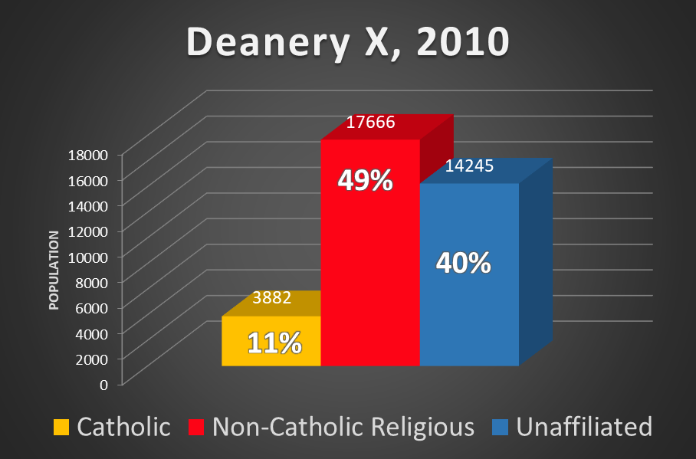
Notes:
Say: Here’s how it breaks out.
Ask: Are you surprised at the results?
Solicit reactions and briefly discuss comments.

Slide 20
Notes:
Say: Here’s how it breaks out.
Ask: Are you surprised at the results?
Solicit reactions and briefly discuss comments.

Slide 21
Post-Christian Ranking
Portland/Auburn, ME
New York, NY
Omaha, NE
Kansas City, KS-MO
Springfield, MO
Wichita, KS
Shreveport, LA
Notes:
Say: The Post-Christian Ranking comes from The Barna Group, a private, not-for-profit research group that analyzes cultural trends related to values, beliefs, attitudes, and behaviors.
It’s a metric to measure the changing religious landscape of American culture. To qualify as “Post-Christian” an individual must meet 9 out of 16 criteria identifying a lack of Christian identity, belief, and practice (add narrative of several criteria). Things like:
Disagree faith is important in their lives
Have not prayed to God in the last week
Have not read the Bible in the last week
Have not attended a Christian church in the last 6 months
This goes beyond loosely identifying as Christian to what people actually believe and how they practice. It gives a more accurate picture of belief and unbelief in American cities.
So, here’s a little exercise. At your table, rank the following cities in order of most to least Post-Christian. When you’re done we’ll look at the results together.

Slide 23
Post-Christian Ranking
[1] Portland/Auburn, ME: 57%
[7] New York, NY: 51%
[31] Omaha, NE : 43%
[61] Kansas City, KS-MO : 32%
[84] Springfield, MO: 24%
[87] Wichita, KS: 23%
[100] Shreveport, LA: 12%
Notes:
Ask: Any thoughts?
Change these cities

Slide 24
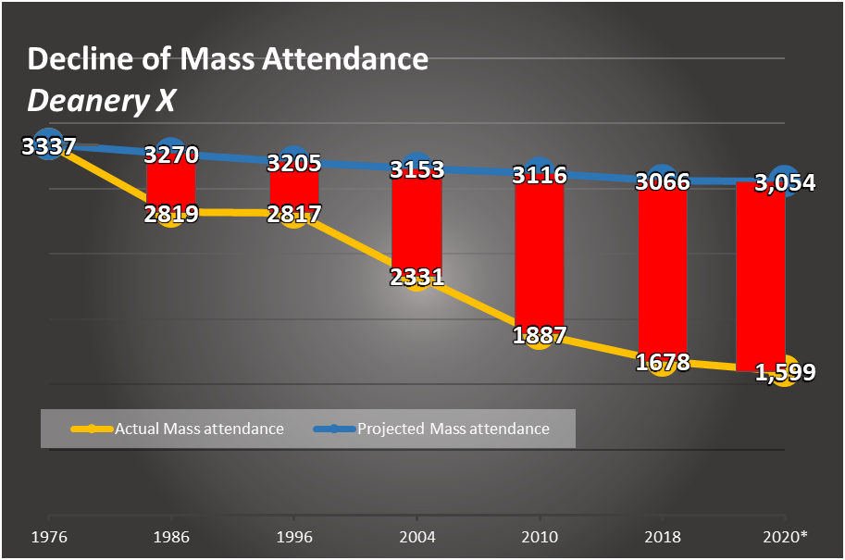
Notes:
Say: Here are the numbers since 1976.
The BLUE line is the projected rate of growth compared to the overall population growth of our entire diocese… this is the maintenance level (same percent of population remains as mass-going Catholics using 1976 as “Year Zero.”
The YELLOW line is actual attendance taken from Spirituality Report information provided by each parish. 44,408 is the 2018 number, the final projection for 2020 at the current rate of decline is 41,600.
Ask: What do these trends tell you?

Slide 25
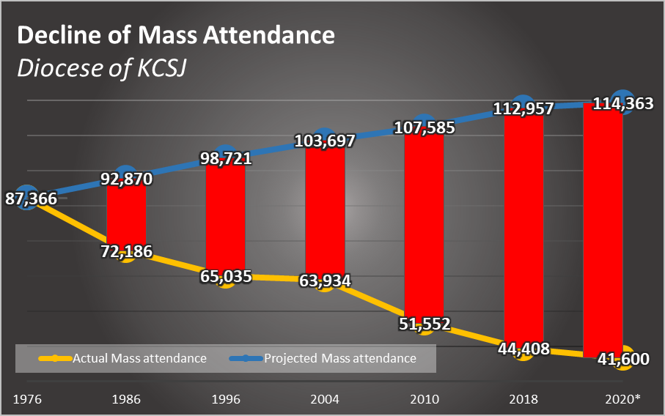
Notes:
Say: Here’s how it breaks out.
Ask: Are you surprised at the results?
Solicit reactions and briefly discuss comments.

Slide 26
Notes:
Ask: What do you see? What do these two graphs tell you? Discuss at your tables.
Have facilitators get a sense of where the discussion is going, then ask a few facilitators to share what they see.

Slide 27
The Call for a “New Evangelization”
All hands on deck
Notes:
Say: If we continue along the current trends, we’ll decrease so much that we won’t have the critical mass necessary to turn these numbers around. Something must be done and it needs to happen now, before it’s too late.
We need a “New Evangelization” and it must include all of us. There aren’t enough clergy to engage all those people. There aren’t enough parish staff either. The call for this New Evangelization is for “all hands on deck” – that means everyone.

Slide 28
“I sense that the moment has come to commit all of the Church's energies to a new evangelization... No believer in Christ, no institution of the Church can avoid this supreme duty: to proclaim Christ to all peoples.” Pope St. John Paul II, Mission of the Redeemer, #3
Notes:
Have participants read this silently.

Slide 29
“The new evangelization calls for personal involvement on the part of each of the baptized. Every Christian is challenged, here and now, to be actively engaged in evangelization; indeed, anyone who has truly experienced God’s saving love does not need much time or lengthy training to go out and proclaim that love.” Pope Francis, The Joy of the Gospel, #120
Notes:
Have participants read this silently.
Ask: Who is challenged to participate in this new evangelization? Every Christian.

Slide 30
How does it make you feel when you hear that Jesus is calling you to evangelize & make disciples?
Notes:
Pair and share
As you’re discussing things, if there’s a word that describes what you’re feeling and thinking, ******write it on a sticky note and put them on the wall
Draw out from pastor and several other people

Slide 31
Notes:
Say: Our new diocesan vision is meant to address this need.
The Vision is a fruit of listening, study, prayer and discernment.

Slide 32
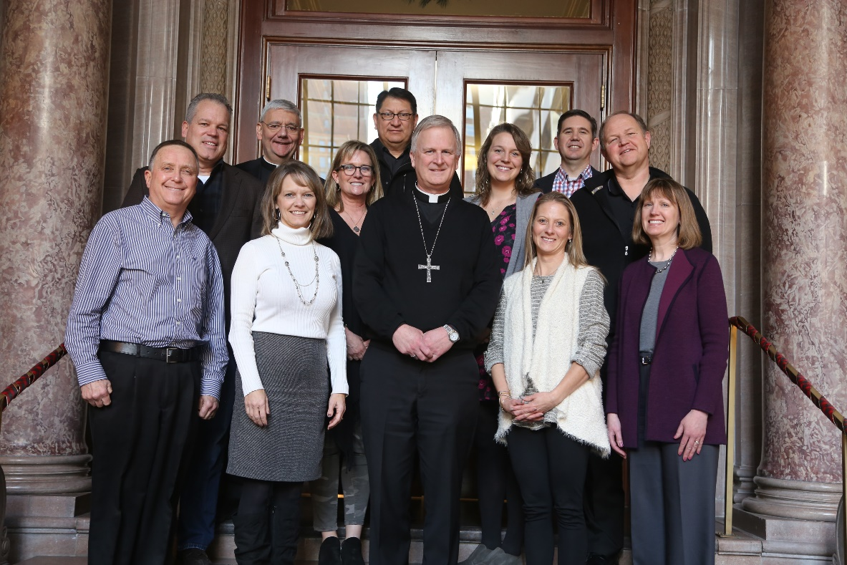
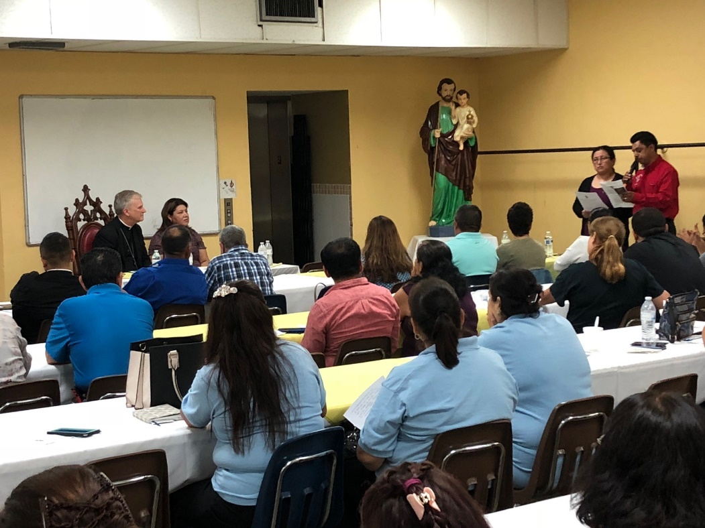
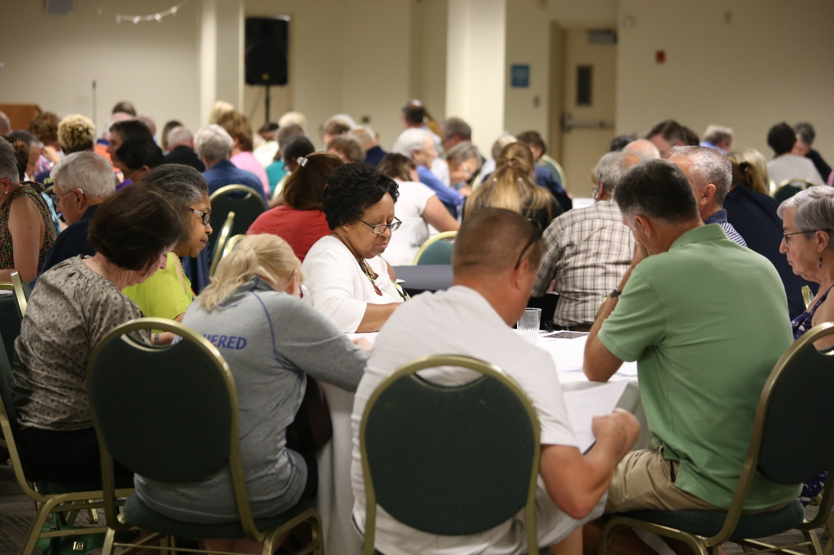
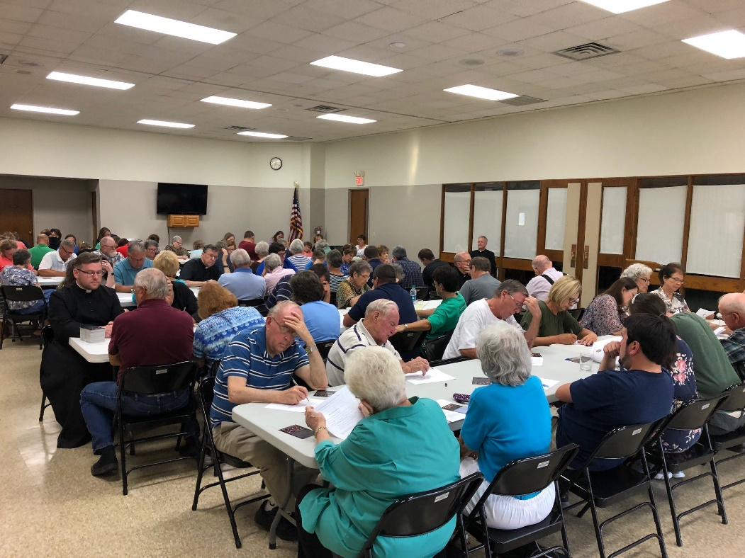
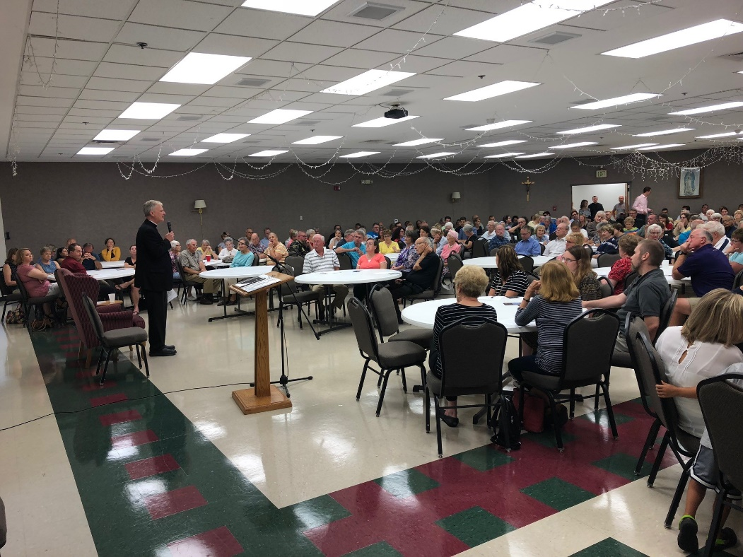
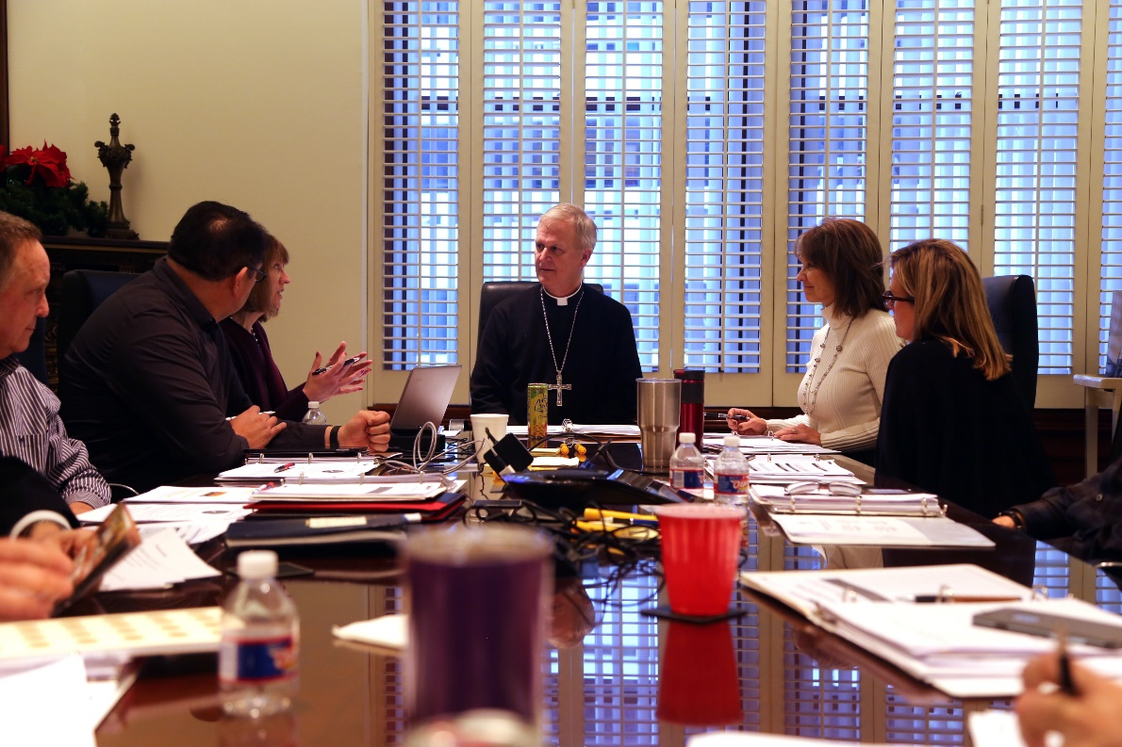
The Visioning Process
Bishop Johnston and the Visioning Team held Listening Sessions at 10 parish locations in Summer 2018. Sessions were also held for priests, chancery employees, and seminarians.
Vision Team
Holy Cross Parish
St. Elizabeth
St. Gregory, Maryville
Our Lady of Guadalupe
Vision Team
Notes:
Many locations were standing room. This helps us more towards a culture of listening in our diocese. People were very respectful and the bishop and his team listened without debate or discussion. All of the input was compiled by the consultants from the Catholic Leadership Institute and the Visioning Team considered all of the input, studied demographic research, read Forming Intentional Disciples and gained insights from key ministry leaders in the diocese.

Slide 33
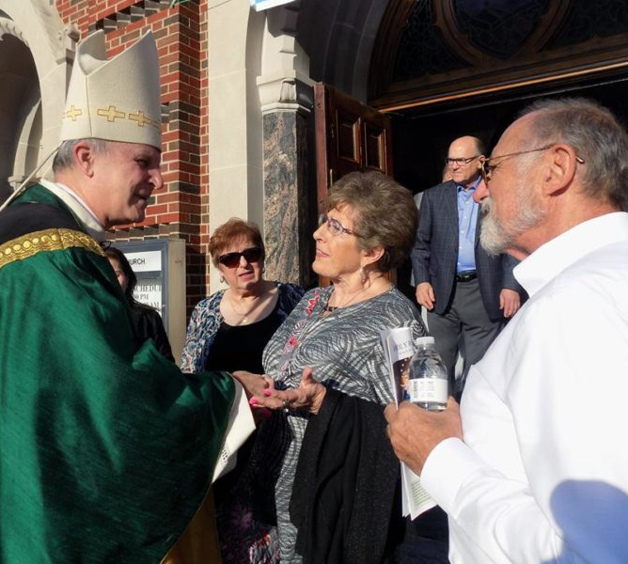
3 Priorities
Notes:
The 3 Priorities are displayed in a graphic that shows their relationship of interdependence (they are equally important, no one is more important than the others).

Slide 34
Healing Our Family
Tending wounds and accompanying hearts to freedom in Christ
Notes:
The starting point to fulfill this vision is to identify our wounds and draw close to Jesus and one another. Freed from the things that weigh us down our hearts are renewed for joyful service.

Slide 35
Using Resources Wisely
Aligning God’s gifts for the Church’s life and mission
Notes:
To serve the mission of the Church – at its core, to evangelize and spread the good news – we identify and align the use of our gifts.
Also about assessing what you already have and evaluating where you can bridge gaps.

Slide 36
Growing God’s Family
Activating our baptismal call to holiness and being disciple-makers
Notes:
Every Catholic is called to respond to the grace of their baptism by becoming a disciples maker.

Slide 37
Discussion
What inspires you most about the Mutually Shared Vision & Priorities?
Notes:
Pair and share. Don’t need to gather and summarize this information. Just getting them to verbalize their ideas.

Slide 38
GOAL: Implement “Clear Path for Discipleship” and hold a diocesan conference by October 2020 to equip all parishes to create a culture of discipleship.
Notes:
The Clear Path Process is actually a goal under this priority.
Conclude this section by stating this point.

Slide 39
Evangelization Strategy
“Raise up Gardeners”
Notes:
What do we need? We have the tools. What we need is more gardeners.

Slide 40
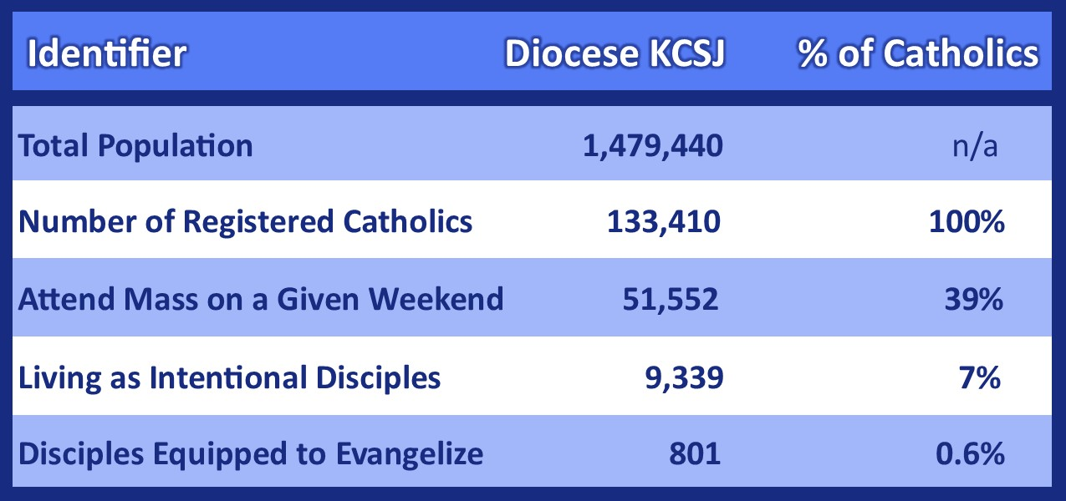
Missionary Disciples in the Diocese of Kansas City-St. Joseph
Notes:
Say: Here’s an estimate of where we were in 2010. (latest U.S. Census data available.)
Total number of Catholics in the diocese is 133,410. In 2010, 39% attended Mass on a given weekend. The number for Intentional Disciples is taken from Matthew Kelley’s book “The Four Signs of a Dynamic Catholic” where he estimates no more than 7% of Catholics are actually living as intentional disciples (Sherry Weddell puts that at a more conservative 3%). However, from further research from Matthew Kelley’s organization, 99.4% of respondents said they’d never been taught to evangelize. Therefore, the number of evangelizers, or missionary disciples in the diocese is probably around .6%...roughly 801 Catholics.

Slide 41
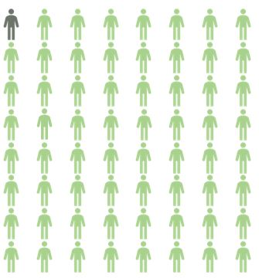
Disciples Equipped to Evangelize
Number attending Mass
1 to 64
Notes:
Say: If we take the number of disciples actually equipped to evangelize right now and compare it to the number of Mass attending Catholics in the diocese, it comes out to a ratio of 1:64. This uses U.S. Census Date and Spirituality Report Data from 2010.

Slide 42
How do you turn them (dark) green?

Slide 43
It is necessary to awaken again in believers a full relationship with Christ, mankind’s only Savior. Only from a personal relationship with Jesus can an effective evangelization develop. Pope St. John Paul II
Notes:
Not how much I know or how hard I work… but primarily from the depth and consistency of my ongoing encounters with Jesus because encounter is the key to evangelization.
(Pope John Paul II, speech to bishops of Southern Germany, Dec. 4, 1992. L’Osservatore Romano(English ed.). Dec. 23/30, 1992, 5-6)

